Slide 1
Outline chapter two
Graphics Hardware
Introduction to Graphics Hardware
Raster Display System
Introduction to 3D graphics pipeline
Z-buffer for hidden surface removal

Slide 2
Introduction to Graphics Hardware
Graphics hardware is the hardware components to quickly render3D objects as pixels on your computer screen.
Graphics Hardware
Display (CRT, LCD, LED,Plasma panels …)
Graphics accelerator
  Scan controller
  Video Memory (frame buffer)
  Display/Graphics Processor
CPU/Memory/Disk …
Today's graphics hardware do have great processing and rendering capacity.

Slide 3
Cathode Ray Tube (CRT)
1
2
3
4
5
6
1. Filament (generate heat)
2. Cathode (emit electrons)
3. Control grid (control intensity)
4. Focus 5. Deflector 6. Phosphor coating

Slide 4
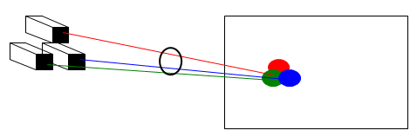
Color CRT
3 electron guns, 3 color phosphor dots at each pixel.
Color = (red, green, blue)
Red = 0 to 100%
Green = 0 to 100%
Blue = 0 to 100%
Black = (0,0,0)
White = (1,1,1)
Red = (1,0,0)
Green = (0,1,0)
Blue = (0,0,1)
…

Slide 5
Reading assignment
Compare and contrast CRT, LCD, LED, Plasma panel display technology based on the following criteria
Cost, Weight, Size
Power consumption
Spatial & Color resolution
Peak brightness, Black, contrast

Slide 6
Display system
Vector display(random-scan)
Random-scan monitors draw a picture one line at a time.
Random-scan systems are designed for line drawing applications.
The component lines of a picture can be drawn and refreshed by a random-scan system in any specified order.
Refresh rate on a random-scan system depends on the number of lines to be displayed.
vector displays generally have higher resolution than raster systems.
produce smooth line drawings because the CRT beam directly follows the line path.

Slide 7
Raster display system
The most common type of graphics display system
The screen (and a picture) consists of discrete pixels
Suitable for realistic display of scene.
How CRT draws a picture
We have only one electron gun but many pixels in a picture need to be lit simultaneously.

Slide 8
Refresh of CRT
Refresh – the electron gun needs to come back to hit the pixel again before it fades out .
An appropriate refresh rate depends on the property of phosphor coating
Typical refresh rate: 60 – 80 times per second (Hz)
(What will happen if refreshing is too slow or too fast?)

Slide 9
Frame Buffer
Frame buffer: the memory to hold the pixel intensity values .
Properties of a frame buffer that affect the graphics performance:
  Size: screen resolution
  Depth: color level
  1 bit/pixel: black and white
  8 bits/pixel: 256 levels of gray
24 bits/pixel: 16 million colors
  Speed: refresh speed

Slide 10
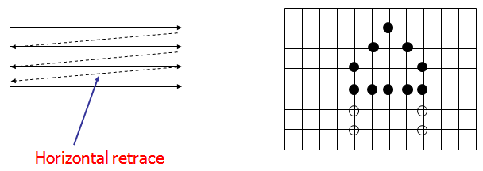
Raster Scan Order
The electron gun will scan through the pixels from left to right, top to bottom (scanline by scanline)

Slide 11
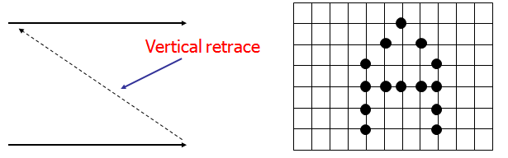
Raster Scan Order
The electron gun will scan through the pixels from left to right, top to bottom (scanline by scanline)

Slide 12
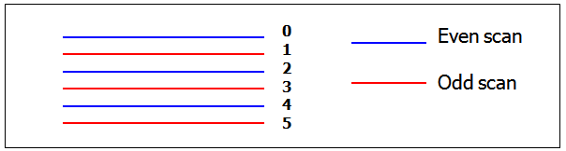
Progressive vs. Interlace
Progressive: Scan every scan line
Interlace: Scan only every other scan line (even -> odd -> even -> odd …)
- so the refresh rate becomes twice as fast

Slide 13
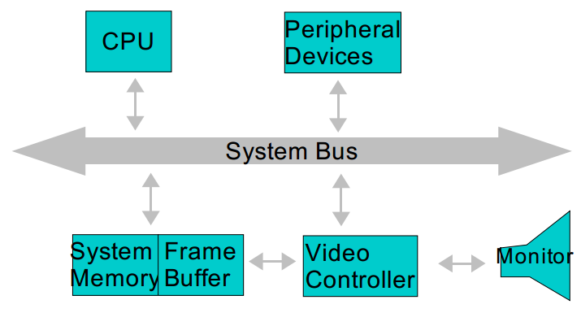
Simple Raster Display
System

Slide 14
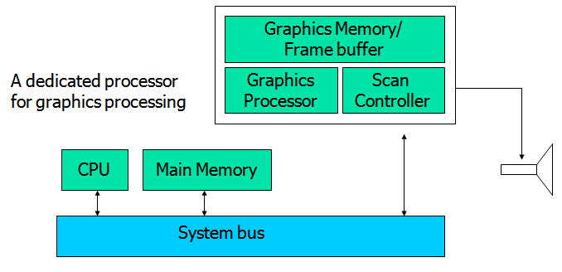
Dedicated GPU and Video RAM

Slide 15
Introduction to 3D graphics pipeline
Model
World
View
NDC
Display
Graphics pipeline: series of stage
Coordinates and transformations
H&B 3-1:60-61

Slide 16
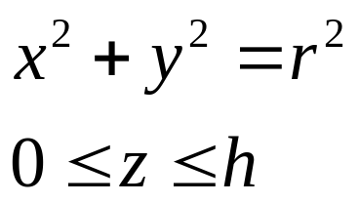
From model to image
Model
World
View
NDC
Display
Cylinder:
Local or modeling coordinates
Geometric modeling

Slide 17
From model to image
Model
World
View
NDC
Display
Position cylinders in scene:
World coordinates
H&B 3-1:60-61

Slide 18
From model to image
Model
World
View
NDC
Display
Look at cylinders,
project on virtual screen
Viewing coordinates
Visible surfaces, shading

Slide 19
From model to image
Model
World
View
NDC
Display
Display:
Normalized Device Coordinates
1
0
1

Slide 20
From model to image
Model
World
View
NDC
Display
Display on screen:
Device Coordinates
0
1024
768
Interaction

Slide 21
Hidden Surface removal
Hidden Surface Removal is the process used to determine which surfaces and parts of surfaces are not visible from a certain viewpoint.
Different hidden surface removal techniques
Z-buffer
C-buffer and S-buffer
Painter algorithm
Ray Casting , BSP tree etc.

Slide 22
Z-buffer for HSR
A commonly used image- space approach to hidden-surface removal.
It is also referred as Depth-Buffer method
Use the intensity color of the nearest 3D point for each pixel.
It has two buffers
Frame buffer:-stores image information
Z-buffer : handle depth information

Slide 23
Z-buffer HSR
Advantages of Z-buffer HSD
No sorting is required. Models can be rendered in any order.
No geometric intersection calculations are required. The algorithm produces the correct output even for intersecting or overlapping triangles.
The algorithm is very simple to implement.
Disadvantage
Needs large memory to keep Z values
Others

Slide 24
group assignment
Select one hidden surface removal technique and explain its basic characteristics using examples?

